Slide 1



Web services
Session
11
Chaim Turkel
Ido Barash

Slide 2


Last session: Spring extras
Spring templates – JDBC template
Spring templates – Transaction template
Spring on web application

Slide 3
Web services
Web-services introduction
JAX-B
SOAP web-services
JAX-WS

Slide 4

WS introduction
As web-development grew, applications needed to share functionality.
An app ‘A’ had to update app ‘B’, or consume data from app ‘C’.
Data exchange must overcome language and platform boundaries: App ‘A’ might be written in JAVA, app ‘C’ might be written in C# and App ‘B’ might be written in PHP.
This data exchange might occur behind the scene and automatically – with no human intervention.

Slide 5
WS introduction
Solution: Web services.
Web service is a piece of code that is accessible over the net and uses standardized messaging system.
Web services are self-contained, modular, distributed little apps that can be invoked over the network to take a specific action.
Web-services allow different apps written in different languages to communicate and exchange data.
Basically, Web services expose API to our app.
Web services are stateless.

Slide 6
WS introduction
Web services use standardized protocol to communicate.
The basic idea is to expose methods and their parameters in a standardized language which both apps can understand.

Slide 7


WS introduction
Web services use standardized protocol to communicate.
The basic idea is to expose methods and their parameters in a standardized language which both apps can understand.
Client App
(Javascript)
Server App
(Java)
network

Slide 8
WS introduction
Web services use standardized protocol to communicate.
The basic idea is to expose methods and their parameters in a standardized language which both apps can understand.
XML is a language all platforms familiar with. It allows us to describe the full data scheme and expose method easily, Regardless to the language we use.
Client App
(Javascript)
Server App
(Java)
XML
network
XML

Slide 9
SOAP
The XML file used to describe the interface of the exposed API is called WSDL – Web Service Description Language.
WSDL describes which methods can be invoked and how.
WSDL contains a reference to a XSD file describing the model object that can be sent and received.
WSDL is basically a language to describe an interface.

Slide 10
SOAP
In order to send or receive an xml message to the web service we need to use a protocol that supports XML messaging over the net.
SOAP (Simple Object Access Protocol)
The SOAP protocol is not tied to any specific transport protocol and can be used via HTTP, SMTP, FTP, etc..
WS example: http://www.webservicex.net/CreditCard.asmx?WSDL

Slide 11



WS introduction – client/server
Before web services:
Browser
Web server
DB

Slide 12




WS introduction – client/server
Web services:
Browser (HTML)
App (JAVA)
App (C#)
SOAP
Web server
DB

Slide 13
JAX-B
JAX-B: Java Architecture for Xml Binding
JAX-B is a specification defining how objects should be converted to XML tags and how we take XML tags and generate objects.
JAX-B is very easy to work with.

Slide 14
JAX-B
JAX-B: Java Architecture for Xml Binding
JAX-B is a specification defining how objects should be converted to XML tags and how we take XML tags and generate objects.
JAX-B is very easy to work with.
Marshalling – Convert Java object to XML.
Unmarashlling – Convert XML to Java object.

Slide 15
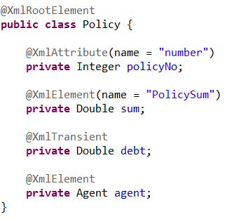
JAX-B
The JAX-B implementation will use reflection API to generate an XML String.
We can influence the final XML using JAX-B annotations:

Slide 16
JAX-B
The JAX-B implementation will use reflection API to generate an XML String.
We can influence the final XML using JAX-B annotations:

Slide 17
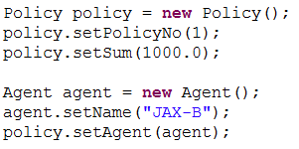
JAX-B
The JAX-B implementation will use reflection API to generate an XML String.
We can influence the final XML using JAX-B annotations:

Slide 18
JAX-B
The JAX-B implementation will use reflection API to generate an XML String.
We can influence the final XML using JAX-B annotations:
<policy number="1">
<PolicySum>10000.0</PolicySum>
<agent>
<name>JAX-B</name>
</agent>
</policy>

Slide 19
JAX-B
The JAX-B implementation will use reflection API to generate an Object out of a XML String.
<policy number="1">
<PolicySum>10000.0</PolicySum>
<agent>
<name>JAX-B</name>
</agent>
</policy>

Slide 20
JAX-B
The JAX-B implementation will use reflection API to generate an Object out of a XML String.
<policy number="1">
<PolicySum>10000.0</PolicySum>
<agent>
<name>JAX-B</name>
</agent>
</policy>

Slide 21
JAX-B
JAX-B is just a specification – we need to use an implementation in order to work with it.
We can add a JAR on our own or use the provided application server’s implementation (JEE).
There are several JAX-B implementations – therefore result XML can be different and annotations usage might change too.

Slide 22
JAX-WS
JAX-WS: Java API for Xml Web Services.
JAX-WS is a specification defining how to expose XML based web services.
Using annotations, JAX-WS will take an interface or a class and generate a WSDL file and all the components needed to transfer and receive data through SOAP messages.
While generating the WSDL, it’ll also use JAX-B annotations to generate the XSD schema.

Slide 23
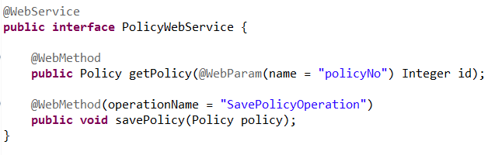
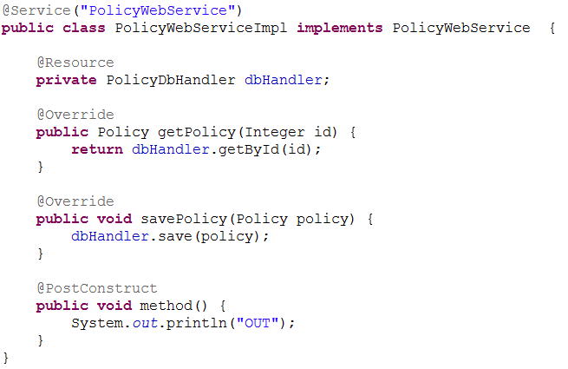
JAX-WS
JAX-WS is very easy to use:

Slide 24
JAX-WS
JAX-WS is very easy to use:

Slide 25
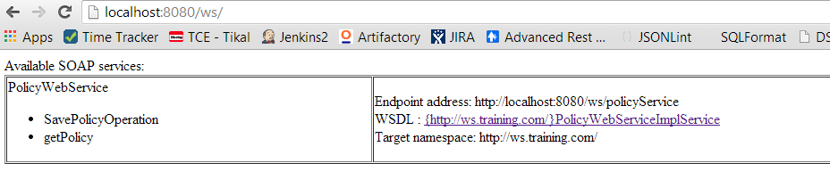
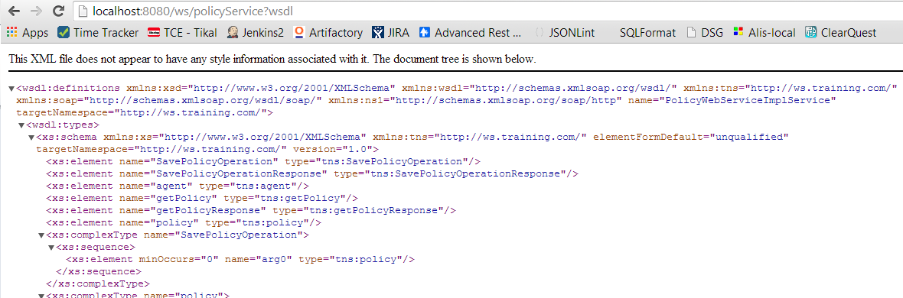
JAX-WS
The generated WSDL file:

Slide 26

JAX-WS
The generated WSDL file:
App server root

Slide 27

JAX-WS
The generated WSDL file:
WSDL file of policy service

Slide 28
JAX-WS
JAX-WS is just a specification. It only defines annotations we can use to create web services easily.
If we use a full JEE app server, we will get the JAX-WS implementation from the app server itself.
Without an app server, we have to provide an implementation JAR on our own and configure it. This can be tricky – since each implementation requires different configuration.
Common implementations: Axis2, CXF, Metro, etc..

Slide 29
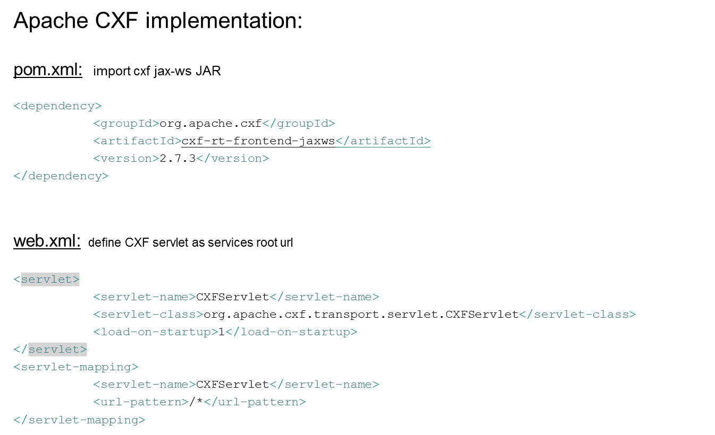
JAX-WS - configuration

Slide 30
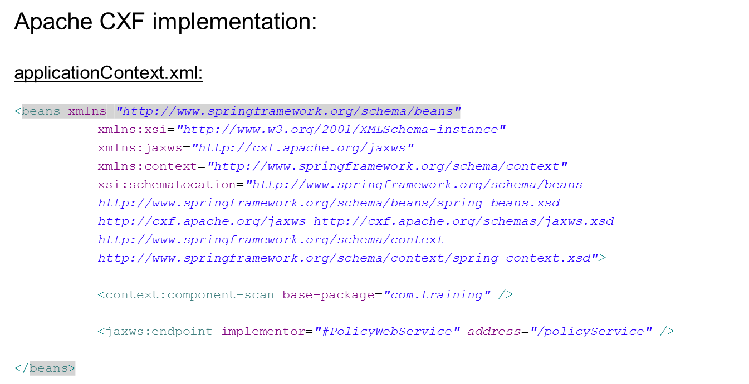
JAX-WS - configuration

Slide 31
JAX-WS - configuration
Every web-service must be binded to an implementing class

Slide 32
JAX-WS - configuration
The ‘#’ marks a Spring managed bean with the following name

Slide 33
JAX-WS - configuration
The ‘#’ marks a Spring managed bean with the following name
(״Service("PolicyWebService@
public class PolicyWebServiceImpl implements PolicyWebService {

Slide 34
JAX-WS - Exercise
Create a calculator web-service exposing the following web methods:
Add (num1, num2)
Increase By One (num1)
Multiply (num1, num3)
Make sure to use proper layers.
Use only integers.
Map service to “/calc”.

Slide 35
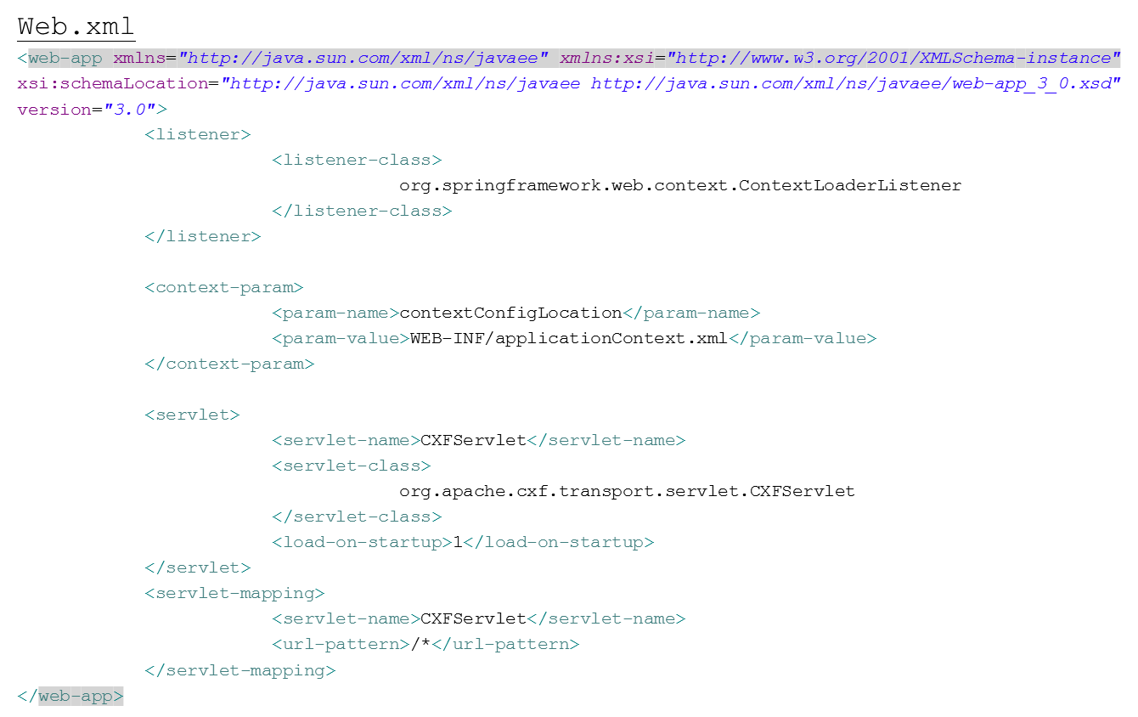
JAX-WS - Exercise

Slide 36
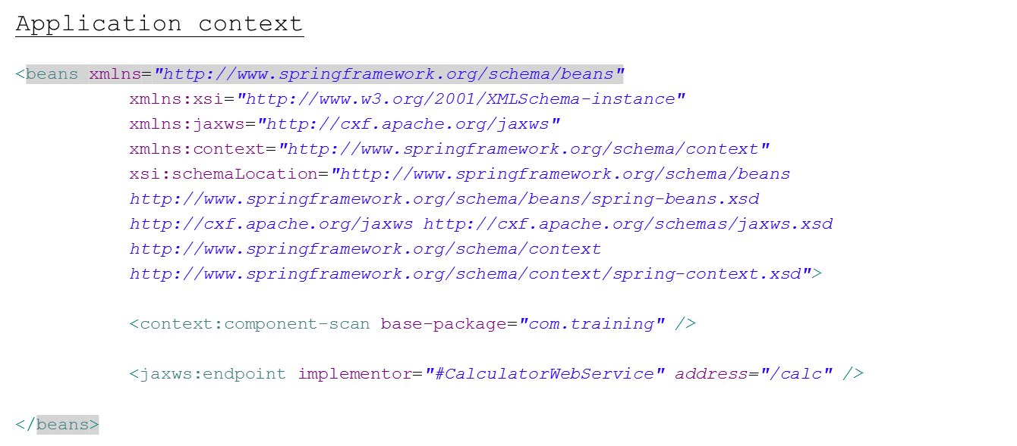
JAX-WS - Exercise

Slide 37
JAX-WS - Exercise
Web service Interface:
@WebService
public interface CalculatorWebService {
@WebMethod
public Integer add(Integer num1, Integer num2);
@WebMethod
public Integer increaseByOne(Integer num1);
@WebMethod
public Integer multiply(Integer num1, Integer num2);
}
Business service interface:
public interface CalculatorBusinessService {
public Integer add(Integer num1, Integer num2);
public Integer multiply(Integer num1, Integer num2);
}

Slide 38
JAX-WS - Exercise
Web service implementation:
@Service("CalculatorWebService")
public class CalculatorWebServiceImpl implements CalculatorWebService {
@Resource
private CalculatorBusinessService calculatorBusinessService;
@Override
public Integer add(Integer num1, Integer num2) {
return calculatorBusinessService.add(num1, num2);
}
@Override
public Integer increaseByOne(Integer num1) {
return calculatorBusinessService.add(num1,1);
}
@Override
public Integer multiply(Integer num1, Integer num2) {
return calculatorBusinessService.multiply(num1, num2);
}
{

Slide 39
JAX-WS - Exercise
Business service implementation:
@Component
public class CalculatorBusinessServiceImpl implements CalculatorBusinessService {
@Override
public Integer add(Integer num1, Integer num2) {
return num1 + num2;
}
@Override
public Integer multiply(Integer num1, Integer num2) {
return num1 * num2;
}
}

Slide 40
Web services
Web-services introduction
JAX-B
SOAP web-services
JAX-WS

Slide 41
Next session – Restful services
Web-services introduction
JAX-B
SOAP web-services
JAX-WS
Session
12

Slide 42


THANK YOU
Ido Barash
Email: ido.barash@tikalk.com

